Slide 1
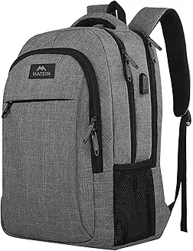
Backpack
By Maria & Kaj

Slide 2
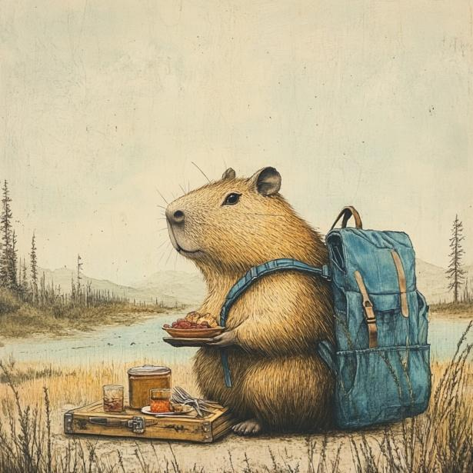
What does the product do
It carries your stuff

Slide 3
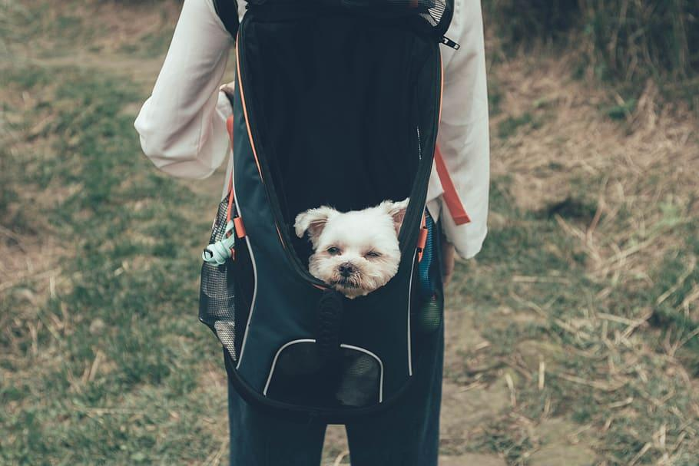
How does it work?
You put your stuff in it then zip the zipper.

Slide 4
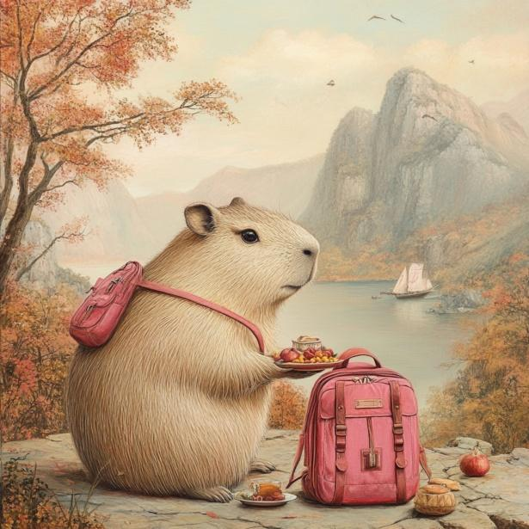

Why is the product better then other competitors

Slide 5
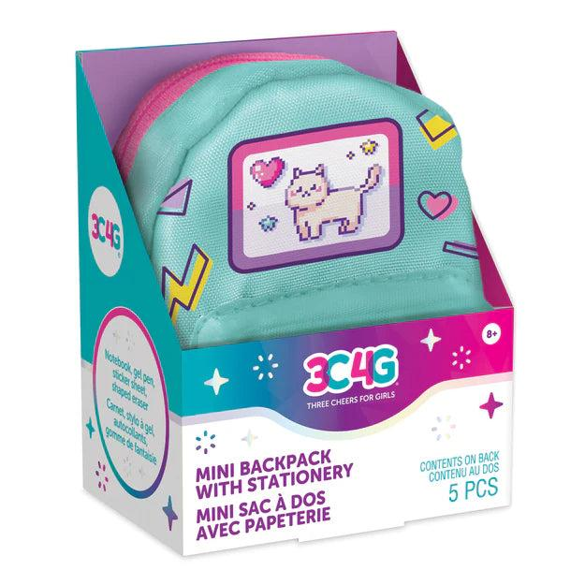
Where are you selling your item?
ROSS, COSTCO,TARGET, etc.

Slide 6
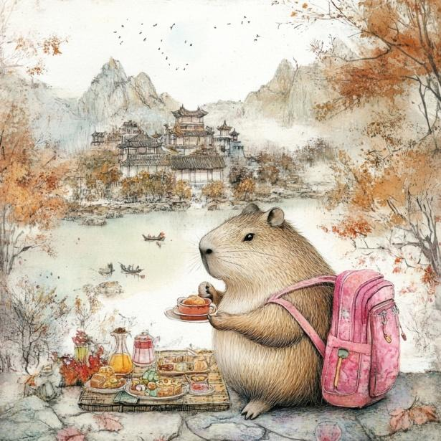

Slide 7
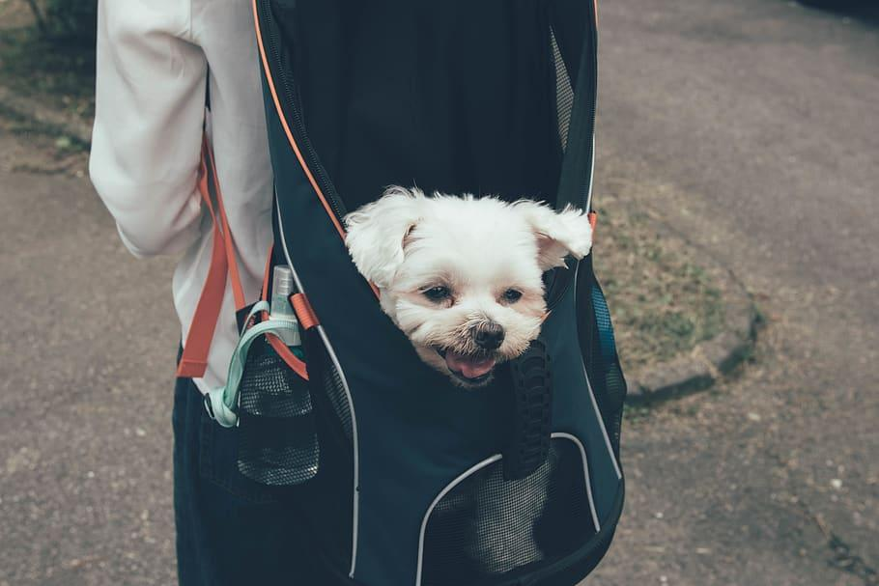
Only $5.00 to $28.00!!!

